Slide 1


DIGITAL TWIN CHALLENGE 2026
GlycoRenal Twin
A digital twin for type 2 diabetes and kidney disease that forecasts glucose and kidney risk and tests treatments before prescribing
Presented By
Shiwangi Singh
B.Pharm, Jamia Hamdard
Shalu Singh
B.Tech, KIET
Notes:
GlycoRenal Twin: our entry for the Digital Twin Challenge 2026. One model per patient with type 2 diabetes that predicts short-term glucose, 3-month HbA1c and 3-year kidney risk, then simulates treatments on the twin. Decision support only: the clinician decides.

Slide 2






Problem & Approach
KEY PROBLEMS
APPROACH
1
Kidney damage is found late
2
Data sits in separate systems
Joins EHR + wearables + patient entries
UACR and eGFR are tested irregularly, so DKD is often caught after function is already lost
Hospital EHR, CGM, home BP and meals rarely appear in one view of the patient
Personal, progressive twin
One
digital twin
per patient
3
Risk scores ignore the individual
4
Treatment choice is complex
Predicts glucose, HbA1c & DKD risk
Population calculators ignore how this patient responds to food, walks and drugs
SGLT2i, GLP-1 RA, finerenone: eligibility depends on eGFR, UACR, potassium, current drugs
Tests & ranks treatments
5
Missed doses go unseen
6
Language barrier
Patient app in EN / हिंदी
Adherence drops between clinic visits and nobody knows until the next HbA1c
Many patients are more comfortable in Hindi than in English-only apps
Clinician makes the final call
101 M
people in India live with diabetes
Up to 40%
of people with diabetes develop kidney disease
Each patient gets one twin built from hospital EHR, wearables and their own entries. The doctor can test a drug on the twin before prescribing it.
ICMR-INDIAB, Lancet Diabetes Endocrinol 2023
IDF Diabetes Atlas
Notes:
Six problems with DKD care in T2DM today, and our approach: one twin per patient that joins data sources, predicts glucose and kidney outcomes, simulates treatments and keeps the clinician in charge.

Slide 3
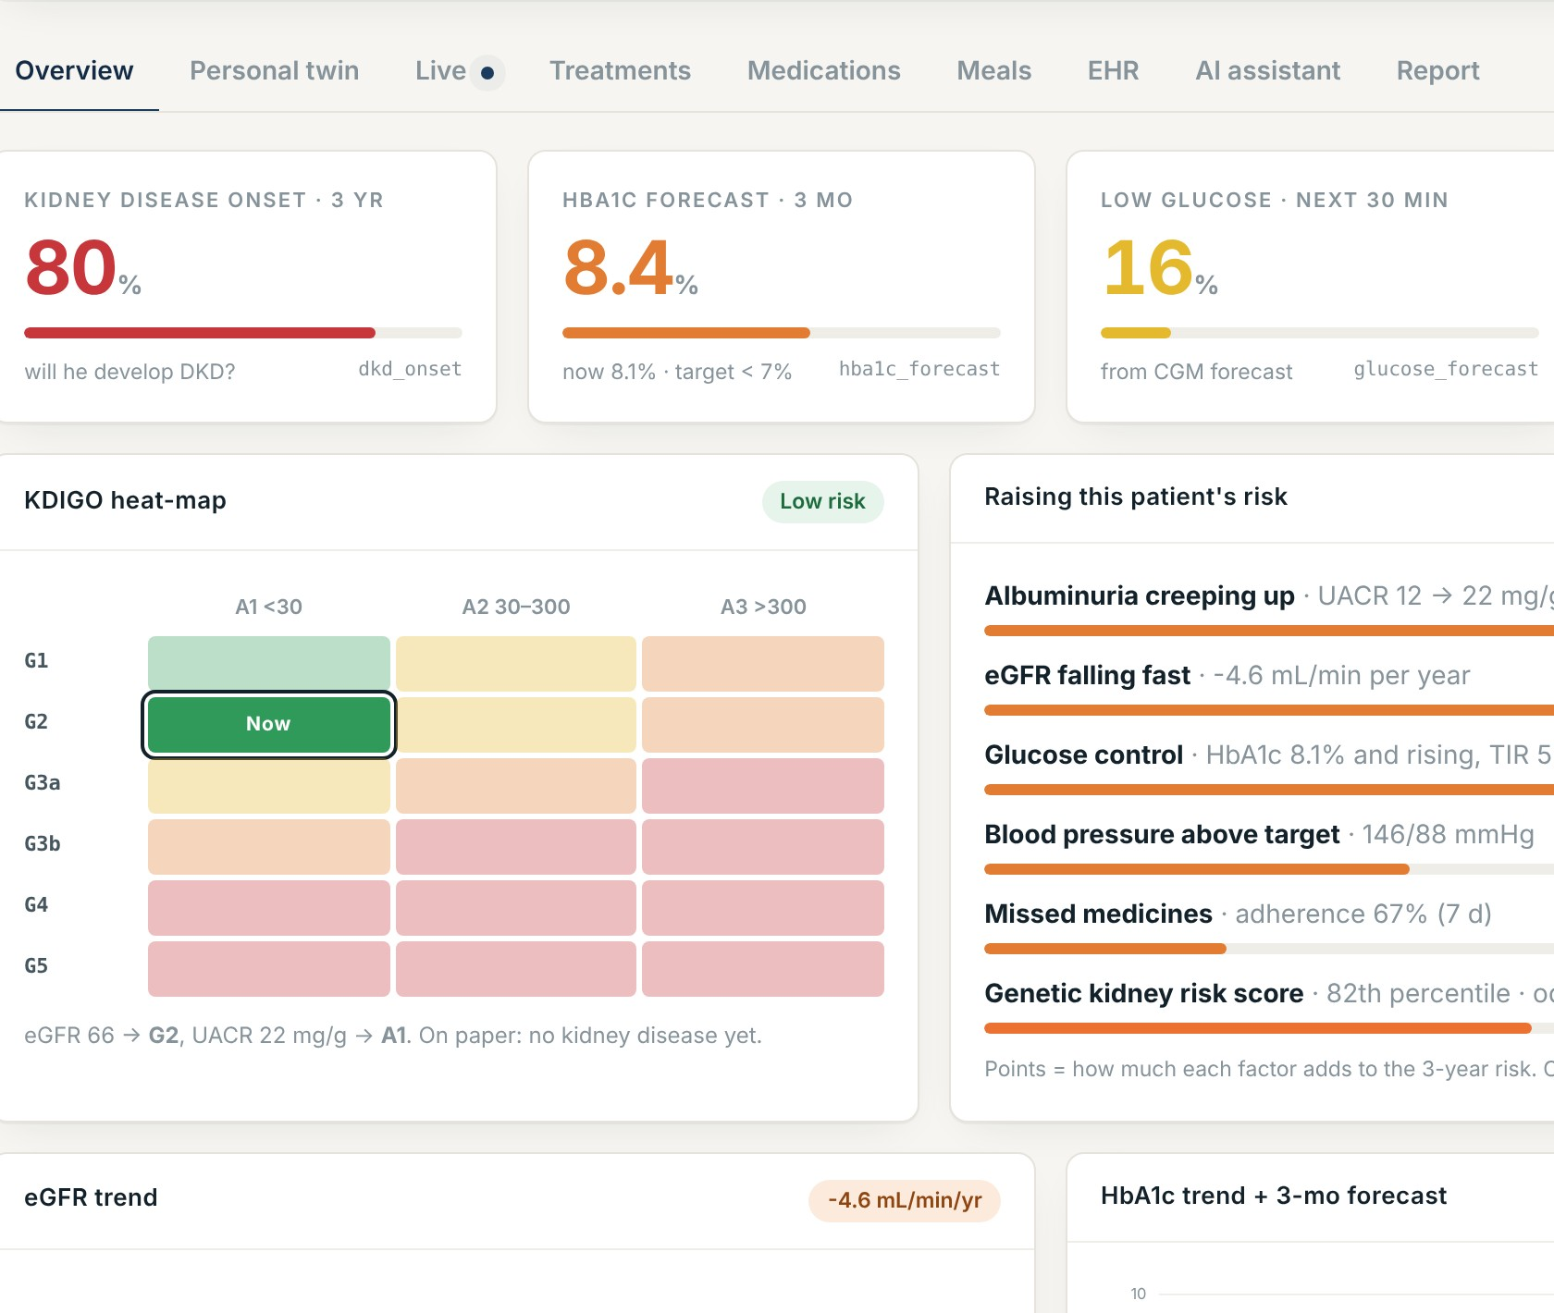
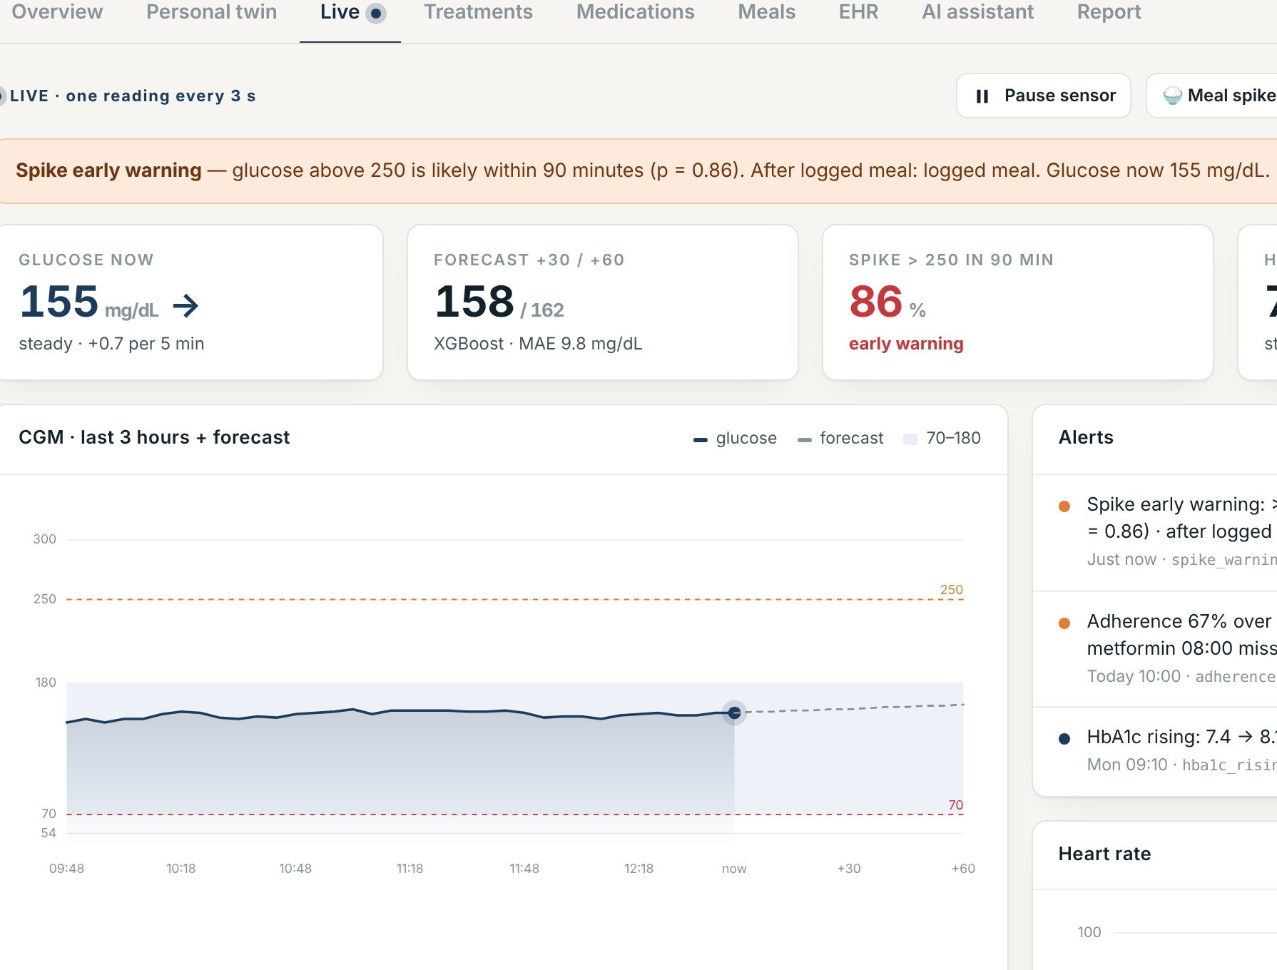
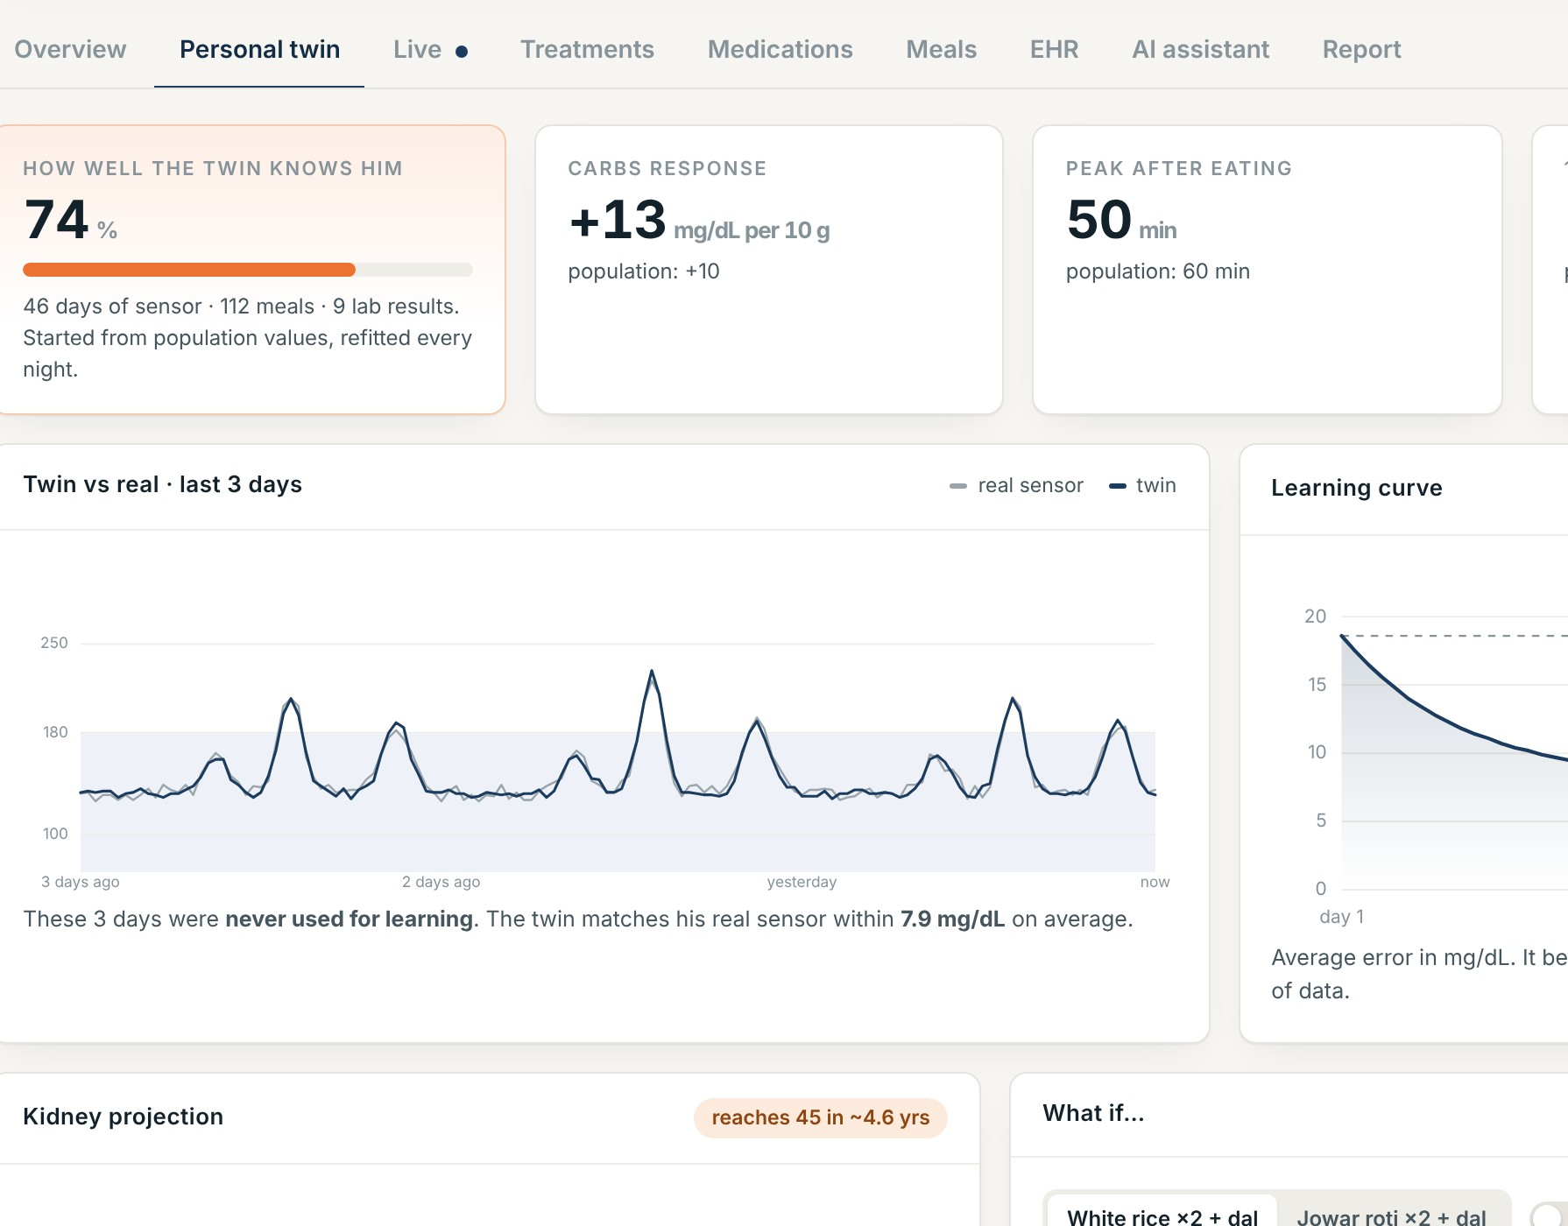
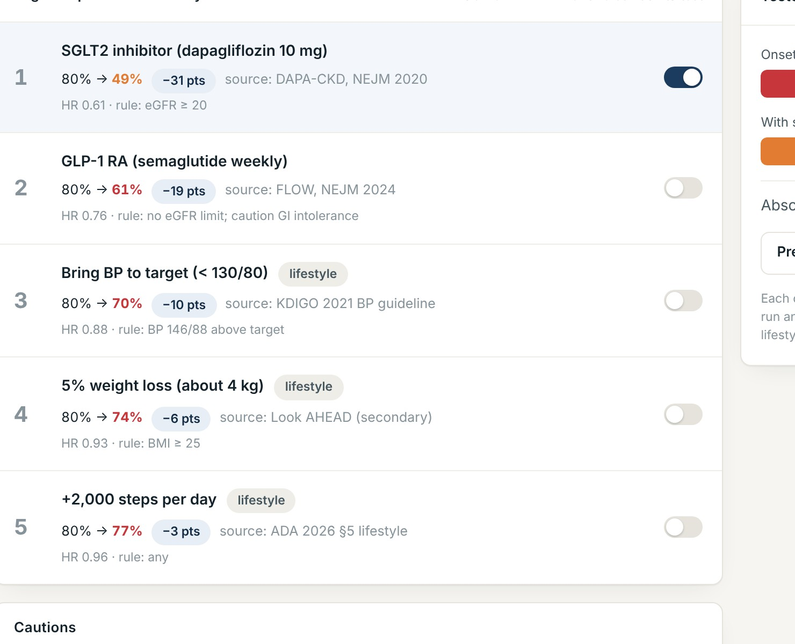
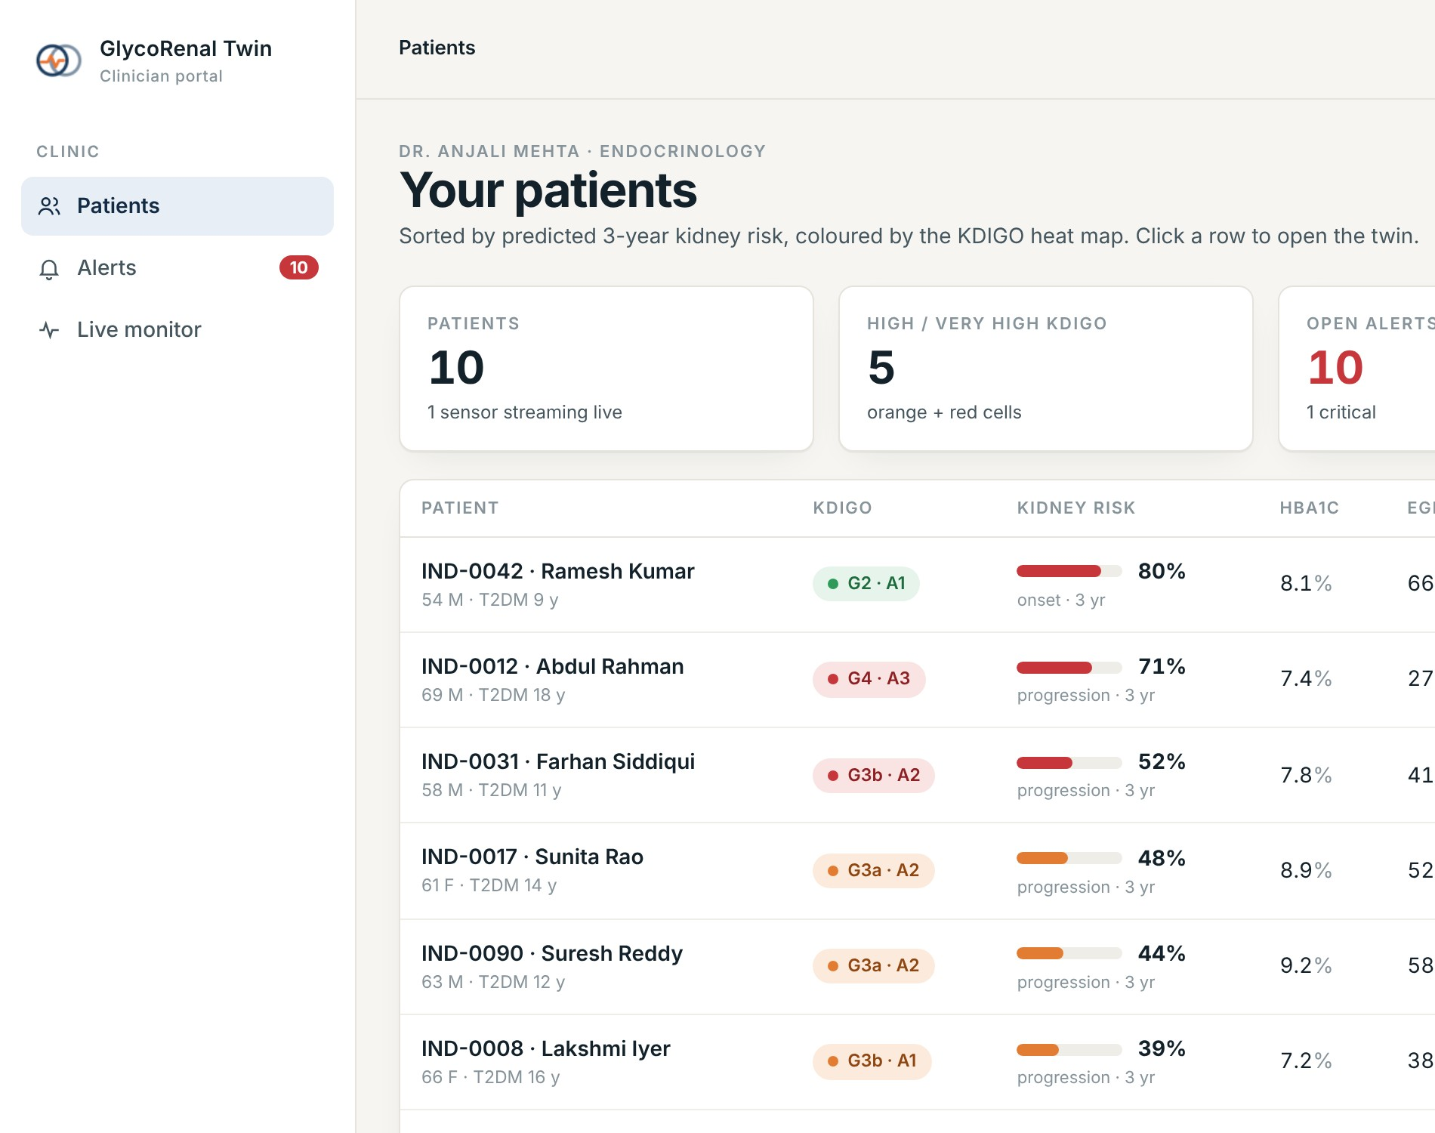
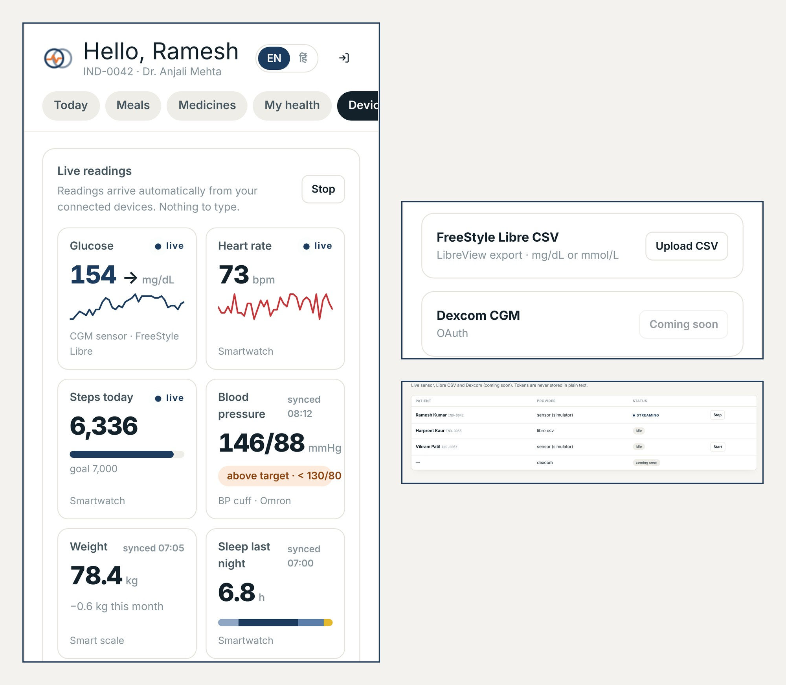
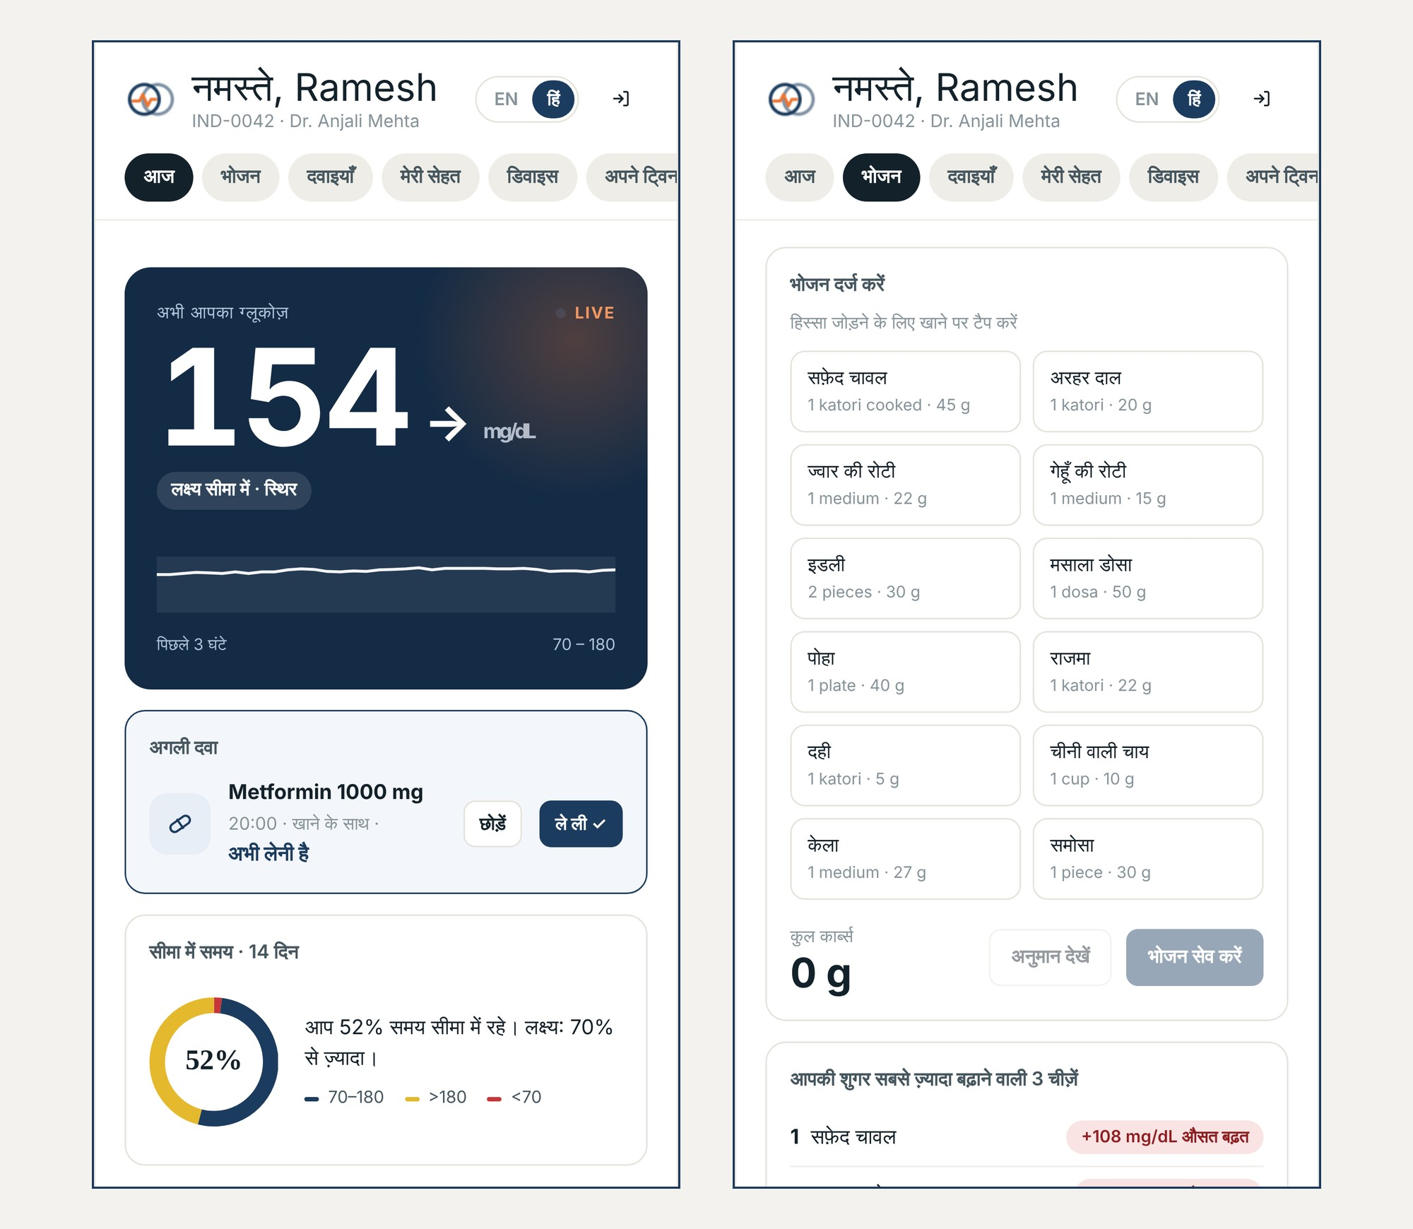
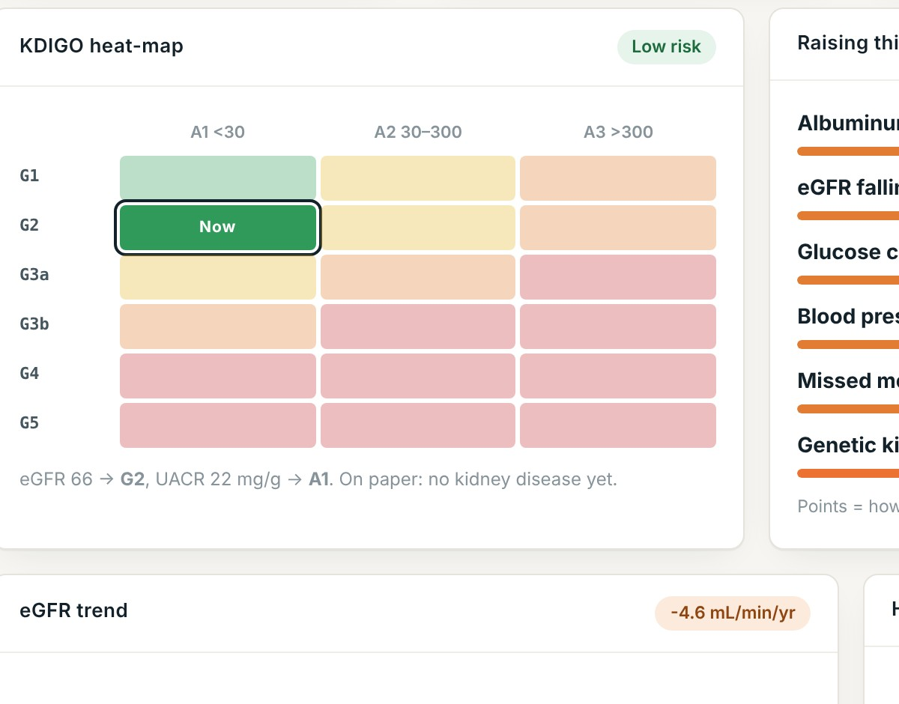
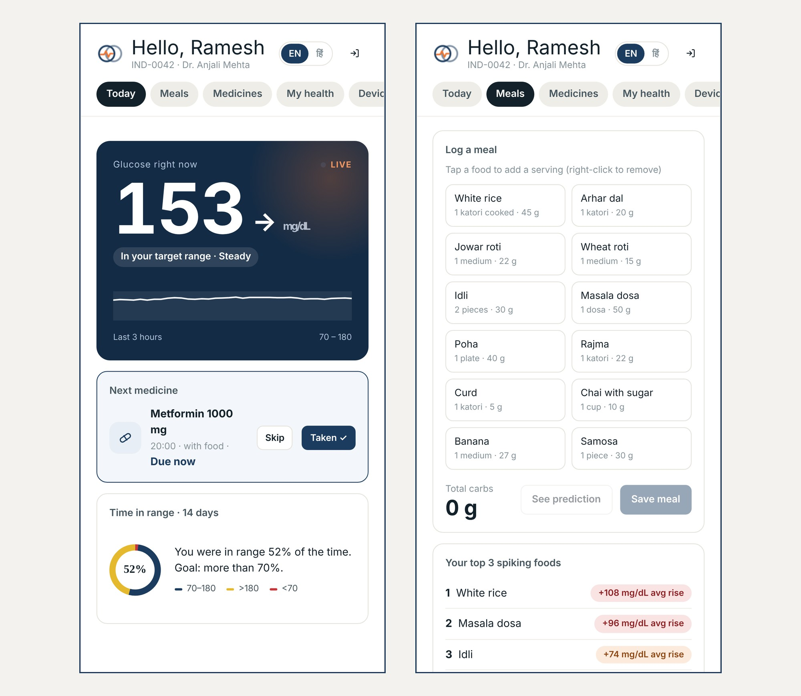
Our USPs
1
Two streams, two outcomes
2
Warns before it happens
3
Progressive twin: learns each patient
EHR and wearables fused; predicts a glucose event today and kidney risk over 3 years.
Spike above 250 mg/dL flagged up to 90 min ahead; 99% caught on synthetic CGM.
Starts at population values and gets more personal every night as the patient's own sensor, meals and labs come in.
4
Test a drug first (for doctors)
5
Working dashboard
6
Device agnostic
Using clinical-trial results and the patient's own history, doctors simulate SGLT2i, GLP-1 RA or finerenone on the twin and see which suits this patient best.
Live doctor portal with 9 tabs per patient, plus patient and admin apps.
Libre, smartwatch, Omron BP, smart scale, CSV upload; Dexcom next; EHR via FHIR R4.
7
Built for India
8
Clinically grounded, privacy-safe
9
Watches over you like a parent
Hindi patient app, Indian meals with carbs and GI, ICMR-INDIAB-based cohort.
KDIGO 2022, ADA 2026, race-free CKD-EPI 2021, LOINC and FHIR R4. Synthetic and open data only; the AI never sees names.
Knows what suits you and what doesn't: your top spiking foods, how much a walk helps, the dose you missed. It reminds and warns before trouble.
Notes:
Nine USPs, each with the screen that shows it. One: EHR and wearables fused to predict a glucose event today and kidney risk over 3 years. Two: spike early warning up to 90 minutes ahead. Three: a progressive twin that learns each patient. Four: doctors test a drug on the twin, using trial results and the patient's history, before prescribing. Five: a working doctor dashboard. Six: device agnostic. Seven: built for India. Eight: clinically grounded and privacy-safe. Nine: the twin watches over the patient like a parent, knowing which foods spike them, how much a walk helps and which dose they missed.

Slide 4
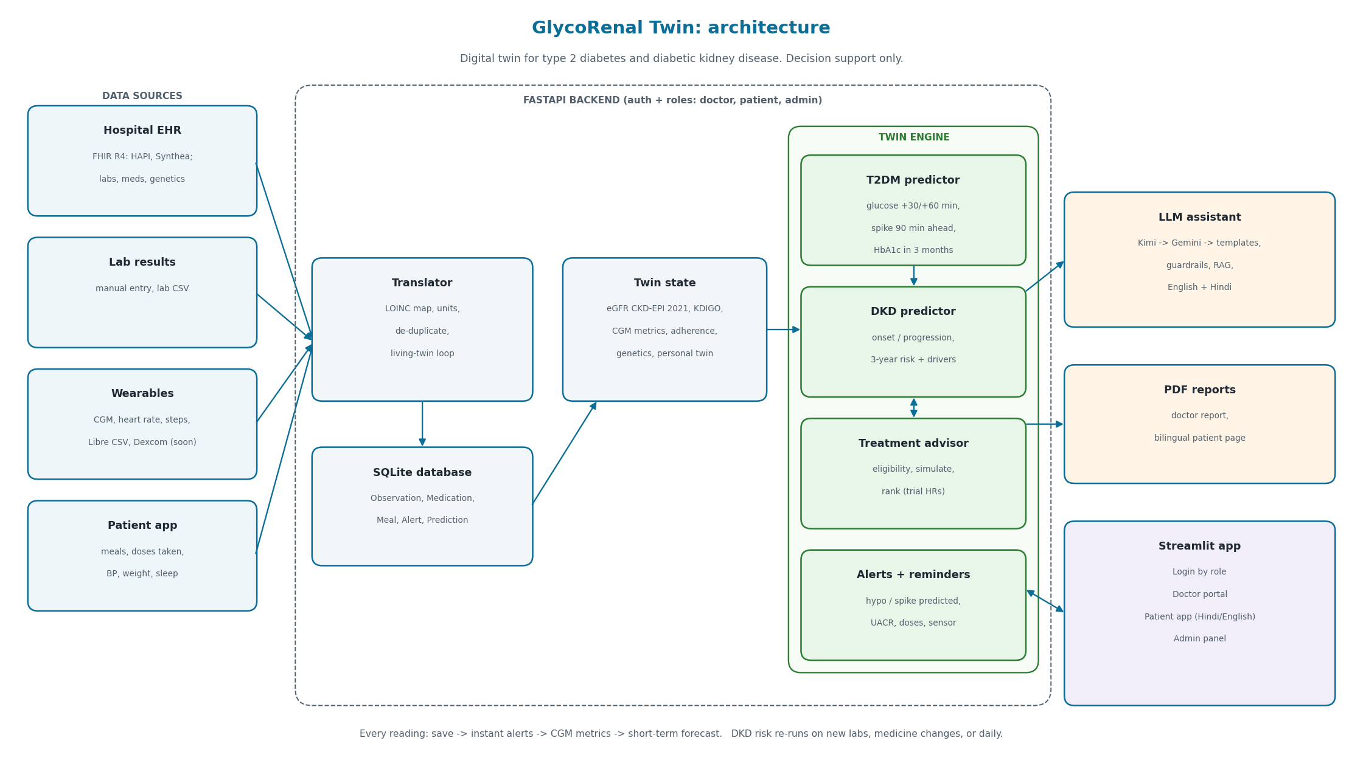
Architecture
Living-twin loop
1
New reading
CGM, lab, dose, meal, BP
2
Translate + save
LOINC, units, de-duplicate
3
Instant alerts
hypo, spike, UACR, K⁺, BP
4
CGM metrics
TIR, TBR, TAR, GMI, CV
Progressive twin
starts at population values, refits nightly on the patient's own data
5
Short-term forecast
glucose +30 / +60 min
6
DKD risk re-run
new labs, medicine change, daily
7
Progressive re-tune
nightly refit on the patient's own data
FastAPI, JWT + bcrypt roles
Streamlit UI
SQLite twin store
FHIR R4 in / out
Progressive twin
Notes:
Four data sources feed the translator, which maps everything to LOINC and stores it in SQLite. The twin state feeds the twin engine: T2DM predictor, DKD predictor, treatment advisor, alerts. Outputs go to the LLM assistant, PDF reports and the Streamlit app. All behind FastAPI with doctor, patient and admin roles. The twin is progressive: it starts at population values and refits every night on the patient's own sensor, meal and lab data, so it becomes more personal over time.

Slide 5




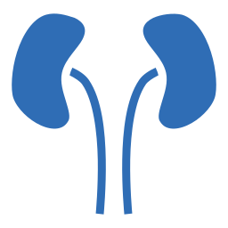




Methodology
INGEST
1
Data in
2
Translator
3
Twin state
FHIR R4 import / export (Synthea, public HAPI)
Lab CSV and manual entry
Live CGM simulator, Libre CSV, Dexcom (soon)
Patient app: meals, doses, BP, weight, sleep
LOINC map + aliases
Unit conversion
De-duplication
Saves Observation, Medication, Meal, Alert, Prediction
eGFR: race-free CKD-EPI 2021
KDIGO G/A stage, heat-map, eGFR slope
14-day CGM: TIR, TBR, TAR, GMI, CV
BP target by albuminuria; 7/30-day adherence
PREDICT & SIMULATE
4
Track A: T2DM predictor
5
Track B: DKD predictor
6
Treatment advisor
Glucose +30 / +60 min
Spike warning 90 min ahead
HbA1c in 3 months
Meal spikes, top 3 spiking foods
3-yr onset (kidneys healthy now)
3-yr progression (DKD now)
Factors driving the risk
Glycaemic features feed the model
Eligibility: KDIGO 2022 / ADA 2026
Simulate each option on the twin
Rank by kidney-risk reduction
Genetic cautions (TCF7L2, CYP2C9, SLC22A1)
ACT & EXPLAIN
7
Alerts & reminders
8
AI assistant
9
Screens & reports
Low/high glucose, predicted hypo
UACR rise, eGFR fall, K⁺, BP, adherence
Sensor off; no repeats within 60 min
Doses: Taken / Skip, missed after 2 h
Kimi, then Gemini, then templates
Explains results, makes no predictions
Cites 8 guideline notes
English + Hindi patient guardrails
Doctor portal
Patient app (English / हिंदी)
Admin panel
Doctor PDF + bilingual patient PDF
Notes:
Nine steps. Ingest: data in, translator, twin state. Predict and simulate: Track A glucose, Track B kidney, treatment advisor. Act and explain: alerts and reminders, AI assistant, screens and PDF reports.

Slide 6


Personal, Progressive Twin
Glucose twin
src/twin/personal_glucose.py
Kidney twin
src/twin/personal_kidney.py
Progressive learning
config/clinical_rules.yaml: personal_twin
A small physiological model (baseline + morning rise + gamma shaped meal responses + walking effect) tuned to the patient's own CGM, meals and heart rate.
The patient's own eGFR and UACR path. It starts from the population slope and is updated by Bayes' rule with every new lab result.
Ridge / Bayesian shrinkage: a new patient starts at population values, and the twin becomes personal as data accumulates.
+12.9
50 min
Projection with an 80% band
Years to eGFR 60 / 45 / 30 for this patient
Same path with treatments applied, side by side
Re-runs on every new eGFR or UACR
Maturity score 0-100%
Learning curve: error vs days of data
History of every re-tune
Re-tuned nightly and on demand
mg/dL per 10 g carbs
to peak after eating
−14
≈ 8
mg/dL after a 15-min walk
mg/dL twin-vs-real error
Prior: the population eGFR slope. Each new eGFR or UACR moves the projection toward this patient's own trend.
A new patient starts with population predictions. The twin shifts to personal values as CGM and lab data build up.
Learned on a demo patient. "Twin vs real" replays the last 3 days, which are not used for tuning. What-if: "if I eat this now / walk after".
Population values
Personal twin
Day 0
more CGM, meals and labs over time
maturity 100%
The same code runs on synthetic, demo and real data (CGMacros, Libre, live sensors, hospital FHIR). Real data improves accuracy.
Notes:
Each patient gets their own model on top of the population prediction. The glucose twin learns carb sensitivity, peak time and walking effect from the patient's own CGM. The kidney twin updates the eGFR and UACR path with Bayes' rule. Shrinkage means it starts at population values and becomes personal as data accumulates.

Slide 7
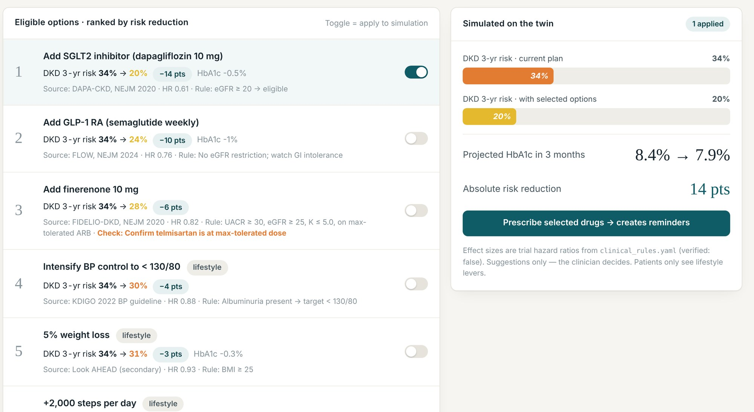
Treatment Advisor
Doctor portal, Treatments tab: options ranked by kidney risk reduction
DECISION FUNNEL: FROM ALL OPTIONS TO A PRESCRIPTION
1 All options
SGLT2i, GLP-1 RA, finerenone, BP control, 5% weight loss, +2,000 steps a day
2 Eligible
KDIGO 2022 / ADA 2026 rules on eGFR, UACR, potassium and current drugs
3 Simulated on the twin
Apply HbA1c, BP and weight change, re-run the DKD model, apply the trial hazard ratio
4 Ranked
by predicted 3-year kidney-risk reduction
34% to 20%
Ramesh Kumar (demo patient)
DKD 3-year risk after adding dapagliflozin 10 mg (DAPA-CKD, HR 0.61); HbA1c 8.4% to 7.9% in 3 months
5 Clinician prescribes
The app creates medicine reminders
TRIAL EFFECT SIZES
DAPA-CKD
CREDENCE
FLOW
FIDELIO-DKD
RENAAL
The clinician decides. Patients see lifestyle suggestions only, not medicine changes.
Effect sizes live in clinical_rules.yaml, each flagged verified: false until checked.
Notes:
The advisor works like a funnel. Start from every option, keep only those eligible under KDIGO 2022 and ADA 2026 rules, simulate each on the twin, rank by kidney-risk reduction, and the clinician prescribes, which creates reminders. For Ramesh, adding dapagliflozin takes 3-year risk from 34% to 20%.

Slide 8
Models, Training & Evaluation
MODELS
Model | Predicts | Trained on | Result
dkd_current | Has DKD now, from non-kidney data | NHANES (real) | AUROC 0.72 (5-fold CV); Asian 0.68
dkd_onset | DKD within 3 years | Synthetic cohort | AUROC 0.90, Brier 0.11
dkd_progression | KDIGO stage worse or eGFR −30% in 3 yrs | Synthetic; UCI check | AUROC 0.87; UCI India 0.93
hba1c_forecast | HbA1c in 3 months | Synthetic cohort | MAE 0.26% when a drug is added (vs 0.39% no-change)
glucose_forecast | Glucose +30 / +60 min | Synthetic CGM | MAE 8 / 12 mg/dL (vs 15 / 24 no-change)
glucose_spike_90m | Glucose > 250 within 90 min | Synthetic CGM | AUROC 0.97
DATA SOURCES
NHANES 2017–2020 (CDC)
1,455 adults with diabetes (real)
UCI CKD (Apollo, India)
400 patients (real), used as a check
Synthetic Indian T2DM cohort
2,000 patients × 5 yrs, quarterly
99%
85 min
94%
of glucose spikes warned
median lead; 74% ≥ 60 min
KDIGO rule matches hospital diagnosis (UCI)
Synthea (MITRE)
FHIR R4 sample bundles
CGMacros (PhysioNet)
CGM for forecast + simulator
Indian foods list
carbs + GI, English + Hindi
Only dkd_current is trained on real patients. High AUROC on the synthetic cohort shows the models learned the simulator's rules. Clinical validation on Indian patients is still to come. Details in models/model_card.md.
Notes:
Six models. Only dkd_current is trained on real patients (NHANES): AUROC 0.72, 0.68 in the Asian subgroup, and progression risk separates CKD on Indian UCI data at 0.93. The rest learn from a synthetic Indian cohort because no open Indian longitudinal dataset exists. Glucose forecast halves the error of a no-change baseline; the spike warning catches 99% of spikes, median 85 minutes ahead. Rebuild pipeline: download_data, nhanes_merge, build_synthetic_cohort, train_models, about 2 minutes plus downloads.

Slide 9
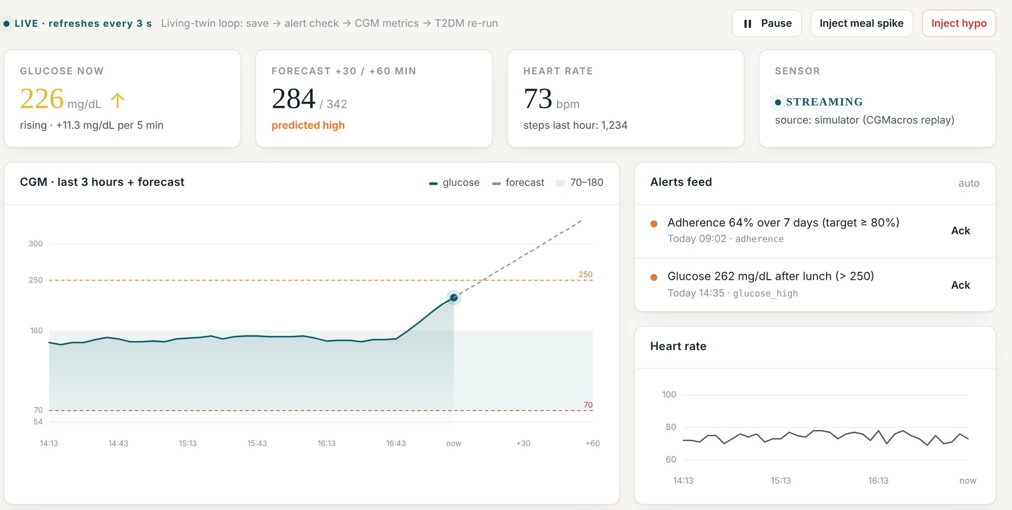
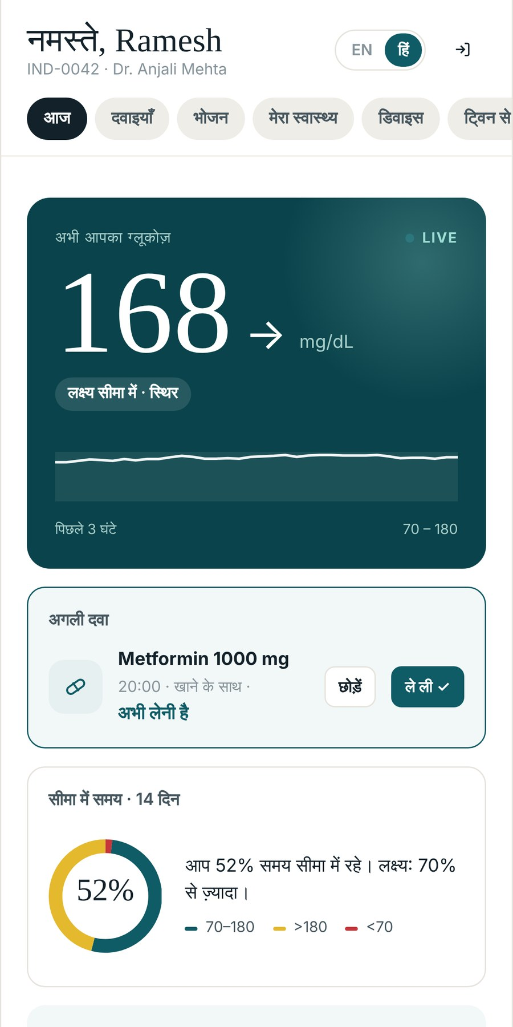
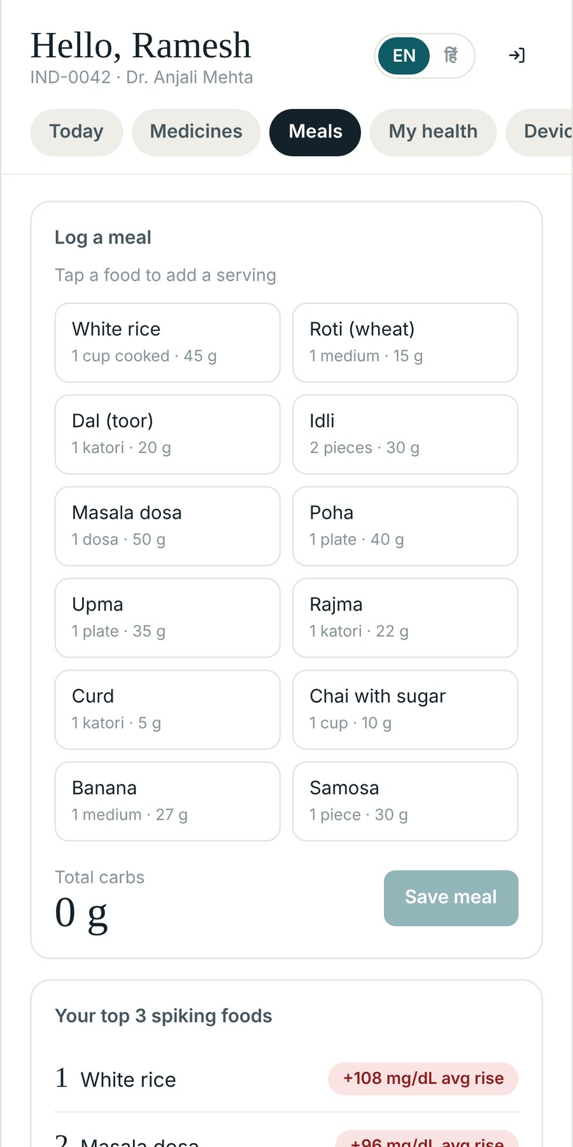
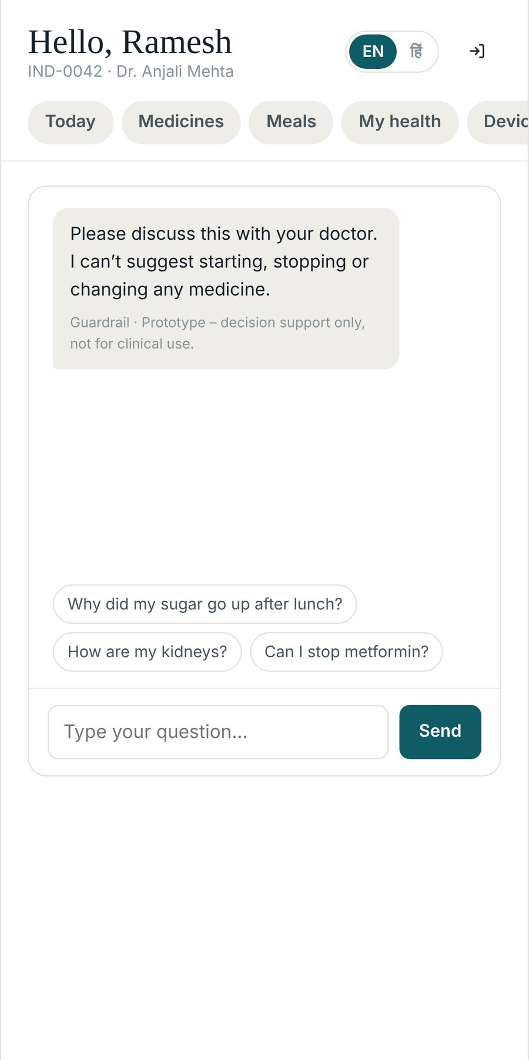


Doctor Portal & Patient App
DOCTOR PORTAL
PATIENT APP IN ENGLISH AND हिंदी
Live monitor: spike predicted after a rice lunch
Live monitor
Alerts & patients
8 tabs per patient
Refreshes every 3 s: glucose, +30/+60 min forecast, heart rate, sensor. Demo buttons inject a meal spike or hypo.
Patients sorted by 3-yr DKD risk with KDIGO chips; one alert queue, no repeats within 60 min.
Overview, Live, Treatments advisor for doctors with live simulations, Medications, Meals, EHR/FHIR, AI assistant, Report.
आज (Today)
Meals
Ask
Live glucose, next dose with Taken / Skip, 14-day time in range (Hindi)
Indian foods with carbs and GI; top 3 spiking foods from own CGM
Medicine questions get one reply: "Please discuss this with your doctor"
Notes:
Doctor side: live monitor during the demo, where a rice lunch pushes glucose to 226 and the forecast shows 284 at +30 minutes. Patients are sorted by kidney risk and every alert lands in one queue. Patient side: Ramesh uses Hindi, Sunita English; one tap switches. Patients see glucose, doses, meals and a guarded assistant. Also: medicines with 7/30-day adherence and My health with numbers vs goals.

Slide 10
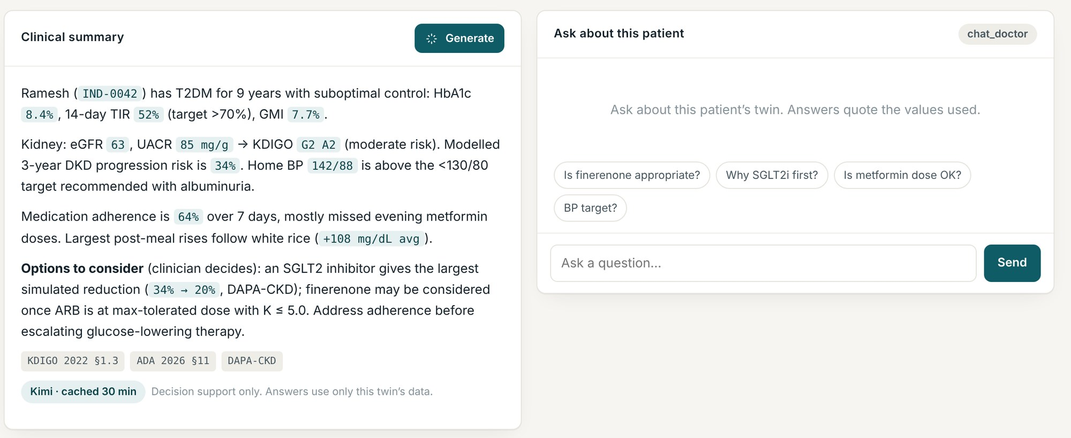
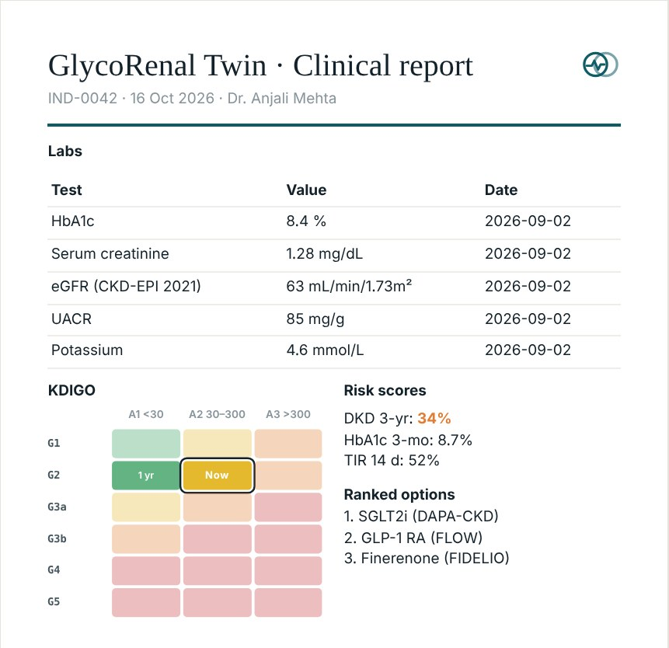



AI Assistant, Safety & Engineering
PDF reports (can be download)
Doctor: labs with freshness flags, KDIGO grid, CGM summary, risk scores with model versions, ranked options, AI summary.
Patient: one page, English + हिंदी.
TECH STACK
LLM chain
Privacy
Patient guardrails
FastAPI
Streamlit
SQLite
JWT + bcrypt
Kimi K2.6 (Moonshot) first, then Gemini, then built-in templates marked "offline summary". It explains the twin's numbers, makes no predictions and cites 8 guideline notes.
Sends only the patient ID and numbers, never names. Called only on a button press or question; answers cached 30 min.
English + Hindi keyword check: no medicine-change advice; low glucose gets a fixed 15-15 message; every answer ends "Decision support only".
FHIR R4
XGBoost
fpdf2
Docker Compose
GitHub Actions
pytest (89 tests)
HF Spaces
CI on every push: pytest, secret check, 35-s demo dry run, then Docker build + smoke test. Clinical rules live in YAML/CSV, editable without Python.
Notes:
The assistant explains the twin and makes no predictions of its own. Kimi first, Gemini fallback, templates if both fail. Only IDs and numbers leave the server. Patient answers pass an English and Hindi guardrail. Engineering: FastAPI + Streamlit, one docker compose command, CI with tests, secret check and the demo dry run. Clinical settings sit in clinical_rules.yaml with a source and verified flag on every block.

Slide 11



Future Scope
TODAY
Scope 1
Scope 2
Scope 3
Scope 4
Working prototype
Run in real hospitals
Test with more devices
WhatsApp and SMS alerts in Indian languages
Get approved and grow
Predicts sugar spikes and kidney risk in type 2 diabetes
Progressive twin that learns each patient
Device agnostic: any sensor, any hospital system
Doctor dashboard with treatment advisor along with patient simulation; patient app in Hindi and English
Pilot with an Indian hospital on anonymised records and compare the twin's predictions with what happened to those patients.
Helps: Hospitals see proof on their own patients before they rely on it.
Try the twin with more sugar sensors (Dexcom and others), smartwatches and home BP machines.
Helps: Patients type nothing, and clinics see one picture whatever device the patient owns.
Reminders and alerts on WhatsApp and SMS, in Hindi and other Indian languages.
Helps: Reaches patients who don't use apps, in small towns and villages.
Apply for CDSCO medical-device approval and keep patient data in India under the DPDP Act.
Helps: Hospitals, insurers and government health programmes can adopt it safely.
HOW IT HELPS ORGANISATIONS
Hospitals and clinics
Health insurers and company health plans
Pharma companies and researchers
Public health programmes
Spot high risk patients early and plan follow-ups before problems turn into emergencies.
Catch kidney decline early, while it is still cheaper to treat.
Test treatment ideas on virtual patients before planning costly studies.
Track diabetes and kidney risk across a district and plan outreach for the areas at highest risk.
Thank you
Notes:
Today we have a working prototype: it predicts sugar spikes and kidney risk, the twin learns each patient over time, and it works with any sensor or hospital system. Next we want to run it in a real Indian hospital, test it with more devices, send WhatsApp and SMS alerts in Hindi and other Indian languages, and get CDSCO approval with data kept in India. It helps hospitals spot high-risk patients early, insurers catch kidney decline while it is cheaper to treat, pharma test ideas on virtual patients, and public health programmes plan outreach for the areas at highest risk. Thank you.

